Slide 1

6th Grade Accelerated Math
Unit 2, Lesson 4 Using Operations to Solve Real-World Problems – Part 1 Volume 1, pg. 55

Slide 2


Benchmark
MA.6.NSO.2.3 Solve multi-step, real-world problems involving any of the four operations with positive multi-digit decimals or positive fractions, including mixed numbers.
volume 1, pg. 55

Slide 3
Integrated Mathematical Thinking and Reasoning Standard
MA.K12.MTR.7.1 Apply mathematics to real-world contexts.
volume 1, pg. 55

Slide 4

Learning Target
I can determine which operation should be used to solve a real-world problem.
volume 1, pg. 55

Slide 5

Warm-Up
volume 1, pg. 56

Slide 6
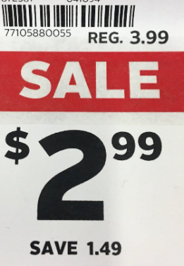
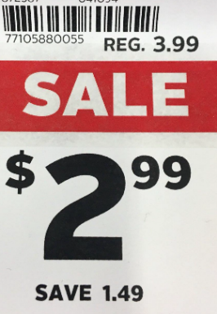
2.4.1 Warm-Up: Math Flop
Determine the mistake in each picture. Then, complete the table.
Math Flop | The Mistake: Which number is not correct? | My Work: Show the math that proves it is a mistake. | The Correct Label: Fix the label by marking out the mistake and inserting the correct number.
volume 1, pg. 56

Slide 7
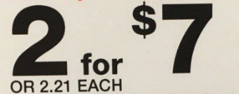
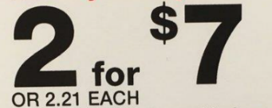
Math Flop | The Mistake: Which number is not correct? | My Work: Show the math that proves it is a mistake. | The Correct Label: Fix the label by marking out the mistake and inserting the correct number.
volume 1, pg. 56

Slide 8

Guided Instruction
volume 1, pg. 56

Slide 9
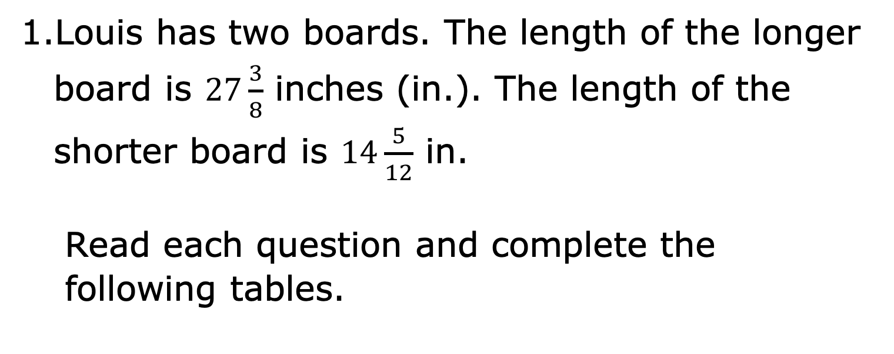
2.4.2 Guided Instruction: Interpreting Real‑World Problems
Louis has two boards. The length of the longer board is $27\frac{3}{8}$ inches (in.). The length of the shorter board is $14\frac{5}{12}$ in.
Read each question and complete the following tables.
volume 1, pg. 56

Slide 10
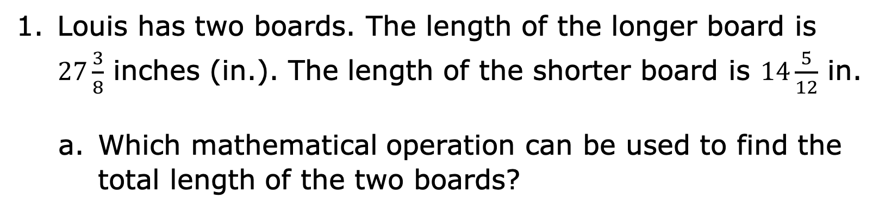
Louis has two boards. The length of the longer board is $27\frac{3}{8}$ inches (in.). The length of the shorter board is $14\frac{5}{12}$ in.
Which mathematical operation can be used to find the total length of the two boards?
Operation | Sketch a picture or explain why you chose that operation.
volume 1, pg. 56

Slide 11
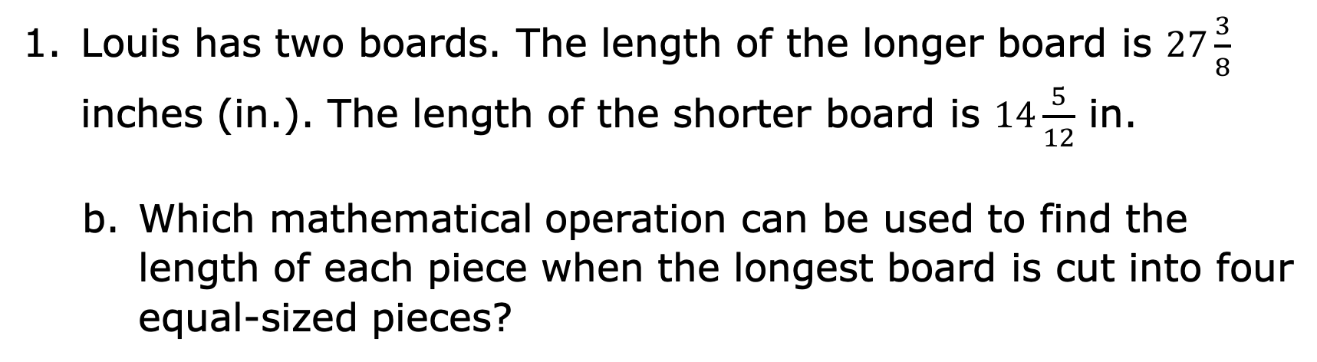
Louis has two boards. The length of the longer board is $27\frac{3}{8}$ inches (in.). The length of the shorter board is $14\frac{5}{12}$ in.
Which mathematical operation can be used to find the length of each piece when the longest board is cut into four equal-sized pieces?
Operation | Sketch a picture or explain why you chose that operation.
volume 1, pg. 56

Slide 12
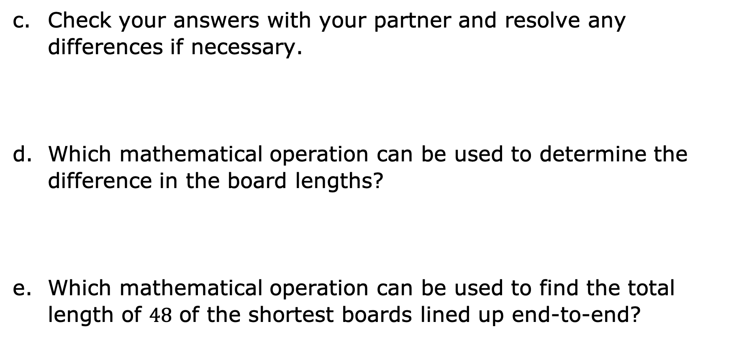
Check your answers with your partner and resolve any differences if necessary.
Which mathematical operation can be used to determine the difference in the board lengths?
Which mathematical operation can be used to find the total length of $48$ of the shortest boards lined up end-to-end?
volume 1, pg. 57

Slide 13
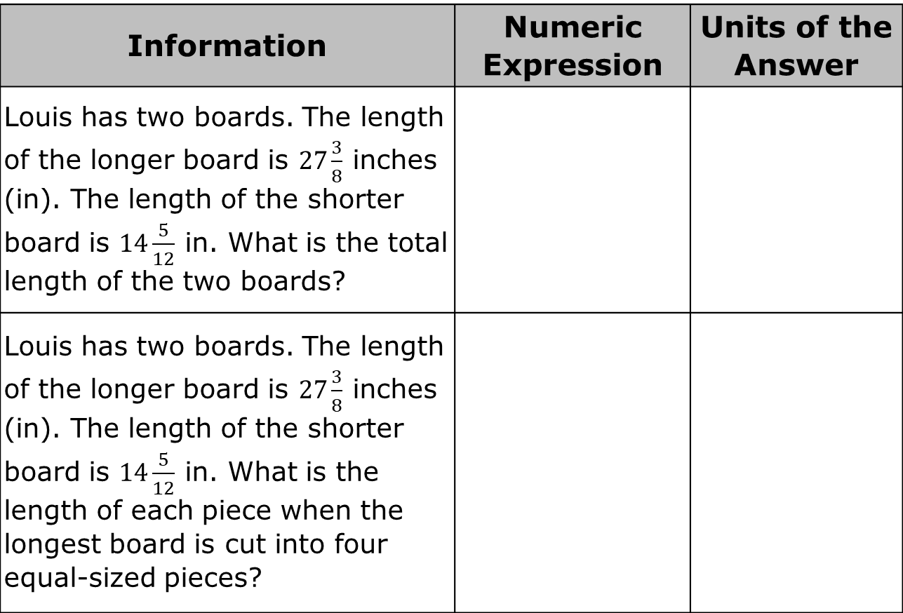
Write the numeric expression that shows how to calculate the answer. Then, determine the units of the answer.
Information | Numeric Expression | Units of the Answer
Louis has two boards. The length of the longer board is $27\frac{3}{8}$ inches (in). The length of the shorter board is $14\frac{5}{12}$ in. What is the total length of the two boards?
Louis has two boards. The length of the longer board is $27\frac{3}{8}$ inches (in). The length of the shorter board is $14\frac{5}{12}$ in. What is the length of each piece when the longest board is cut into four equal-sized pieces?
volume 1, pg. 57

Slide 14
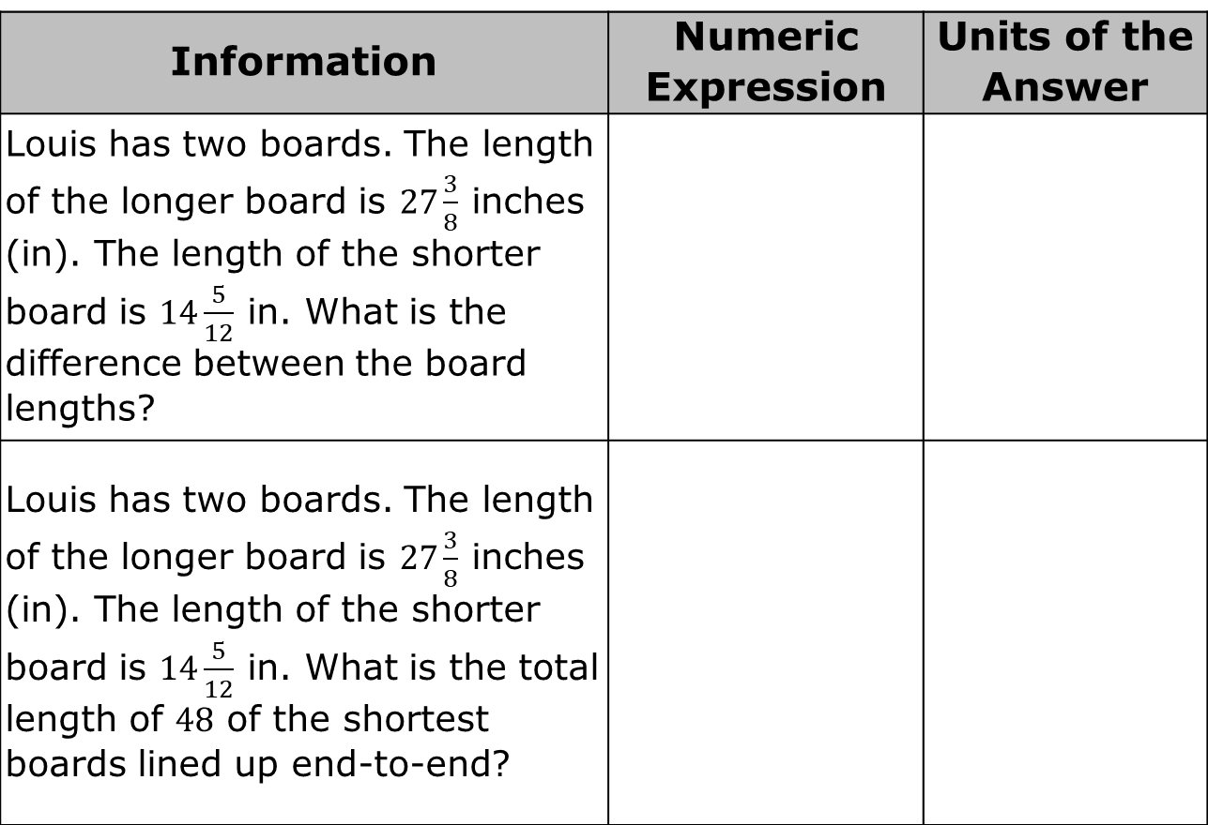
Information | Numeric Expression | Units of the Answer
Louis has two boards. The length of the longer board is $27\frac{3}{8}$ inches (in). The length of the shorter board is $14\frac{5}{12}$ in. What is the difference between the board lengths?
Louis has two boards. The length of the longer board is $27\frac{3}{8}$ inches (in). The length of the shorter board is $14\frac{5}{12}$ in. What is the total length of $48$ of the shortest boards lined up end-to-end?
volume 1, pg. 57

Slide 15

Guided Practice
volume 1, pg. 58

Slide 16

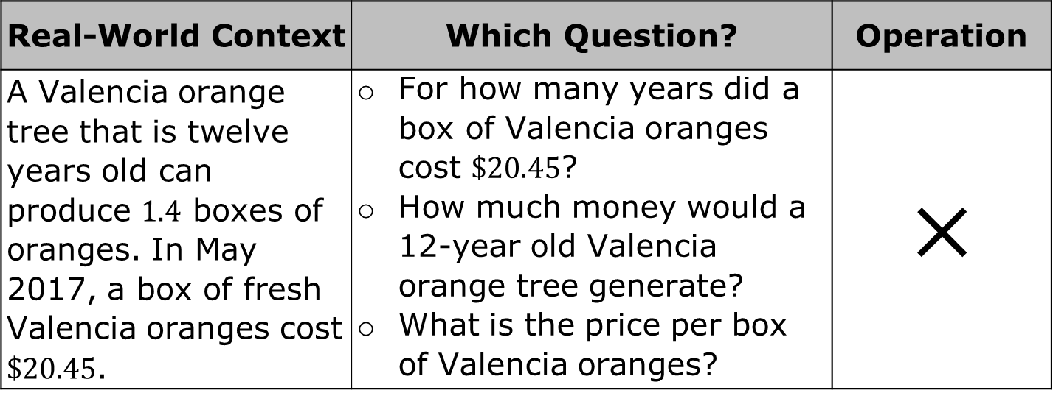
2.4.3 Guided Practice: Operations in Real‑World Context
The table contains four different real-world contexts. Select the question in the middle column that requires the use of the operation indicated in the last column within this context.
Real-World Context | Which Question? | Operation
A Valencia orange tree that is twelve years old can produce $1.4$ boxes of oranges. In May 2017, a box of fresh Valencia oranges cost $\$20.45$. | For how many years did a box of Valencia oranges cost $\$20.45$? How much money would a 12-year old Valencia orange tree generate? What is the price per box of Valencia oranges? | $$×$$
volume 1, pg. 58

Slide 17
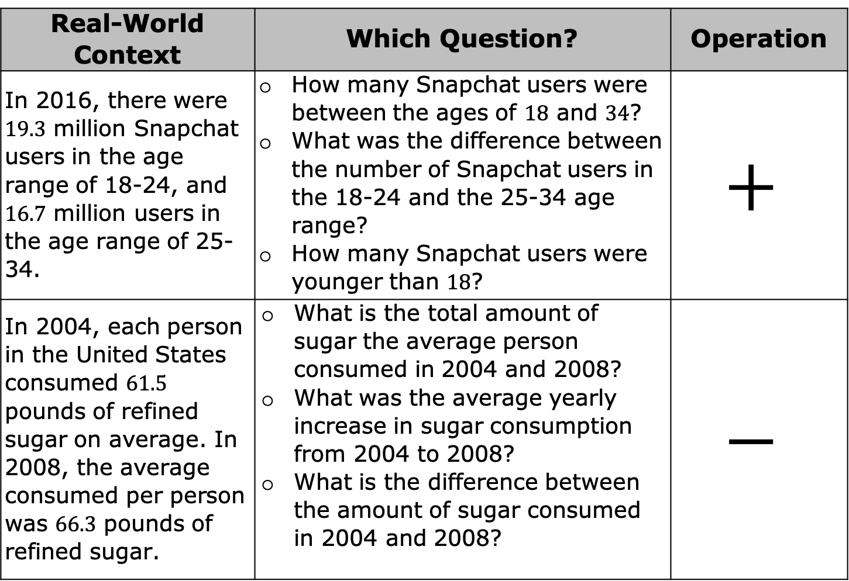
Real-World Context | Which Question? | Operation
In 2016, there were $19.3$ million Snapchat users in the age range of 18-24, and $16.7$ million users in the age range of 25-34. | How many Snapchat users were between the ages of $18$ and $34$? What was the difference between the number of Snapchat users in the 18-24 and the 25-34 age range? How many Snapchat users were younger than $18$? | $$+$$
In 2004, each person in the United States consumed $61.5$ pounds of refined sugar on average. In 2008, the average consumed per person was $66.3$ pounds of refined sugar. | What is the total amount of sugar the average person consumed in 2004 and 2008? What was the average yearly increase in sugar consumption from 2004 to 2008? What is the difference between the amount of sugar consumed in 2004 and 2008? | $$−$$
volume 1, pg. 58

Slide 18
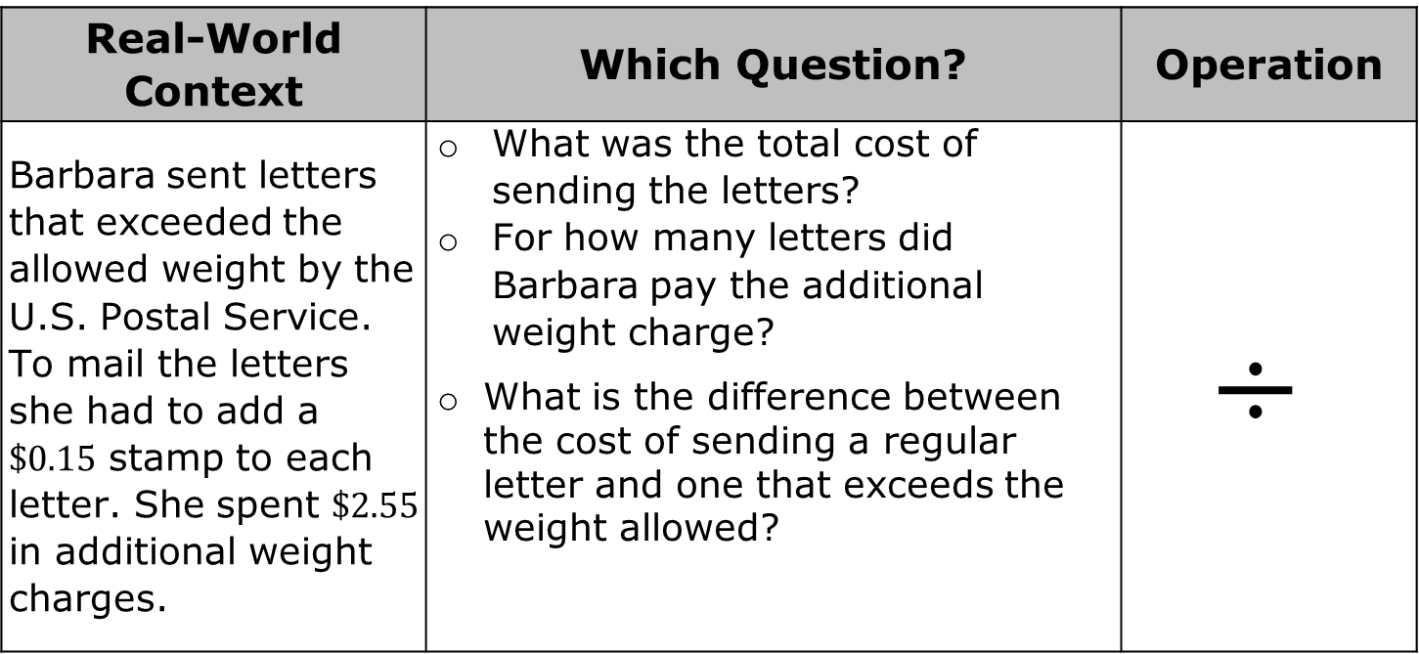
Real-World Context | Which Question? | Operation
Barbara sent letters that exceeded the allowed weight by the U.S. Postal Service. To mail the letters she had to add a $\$0.15$ stamp to each letter. She spent $\$2.55$ in additional weight charges. | What was the total cost of sending the letters? For how many letters did Barbara pay the additional weight charge? What is the difference between the cost of sending a regular letter and one that exceeds the weight allowed? | $$÷$$
volume 1, pg. 58

Slide 19
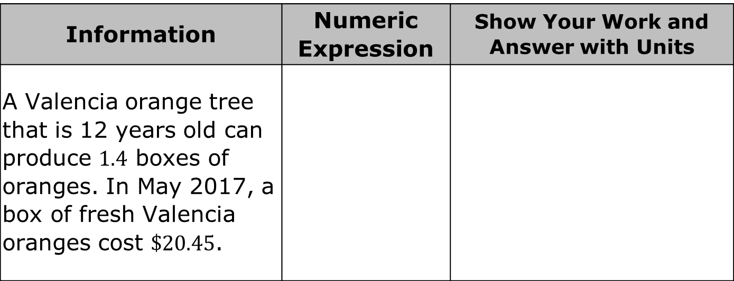
Use the same four real-world contexts and the operation indicated to find the answer to the question selected in the previous table. Write the numeric expression used to determine the answer. Then, show your work and write the answer using the correct units.
Information | Numeric Expression | Show Your Work and Answer with Units
A Valencia orange tree that is 12 years old can produce $1.4$ boxes of oranges. In May 2017, a box of fresh Valencia oranges cost $\$20.45$.
volume 1, pg. 59

Slide 20
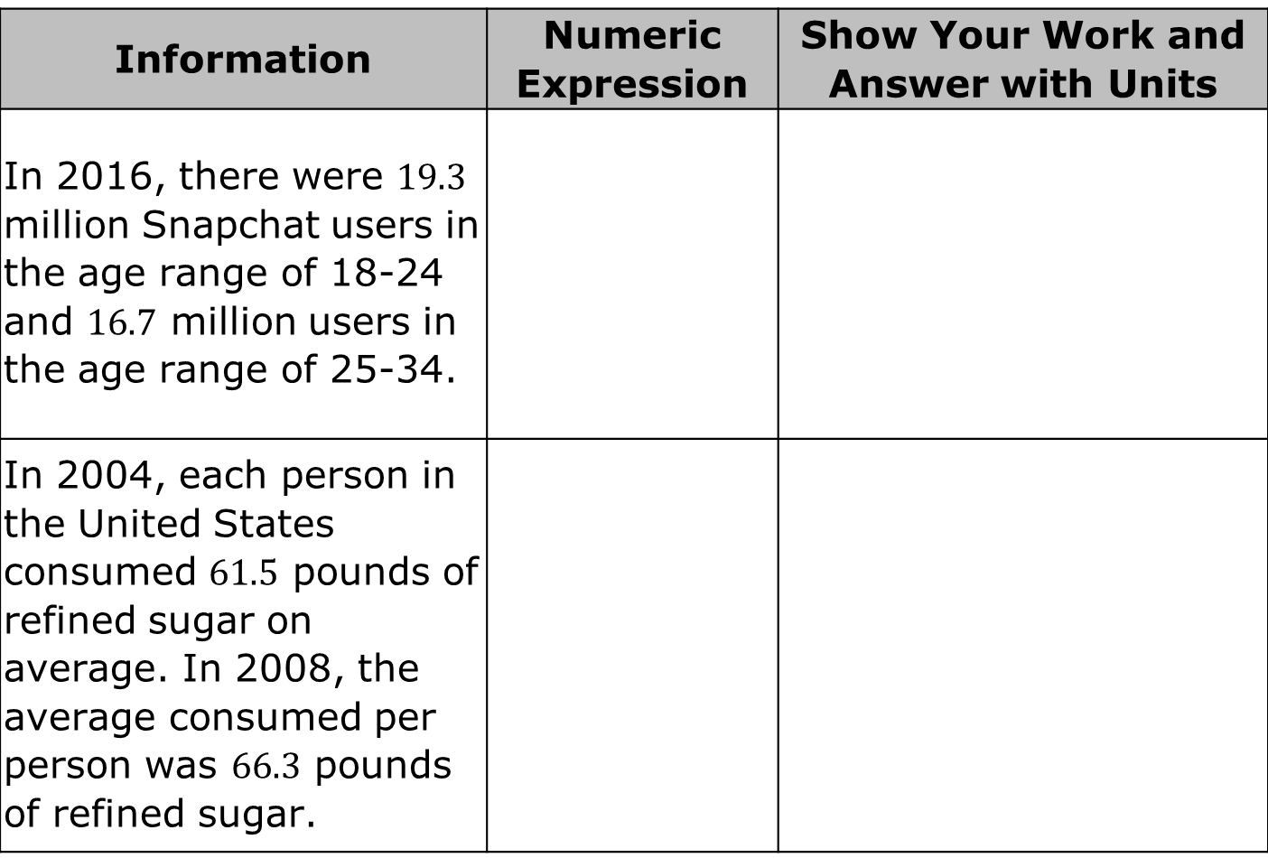
Information | Numeric Expression | Show Your Work and Answer with Units
In 2016, there were $19.3$ million Snapchat users in the age range of 18-24 and $16.7$ million users in the age range of 25-34.
In 2004, each person in the United States consumed $61.5$ pounds of refined sugar on average. In 2008, the average consumed per person was $66.3$ pounds of refined sugar.
volume 1, pg. 59

Slide 21
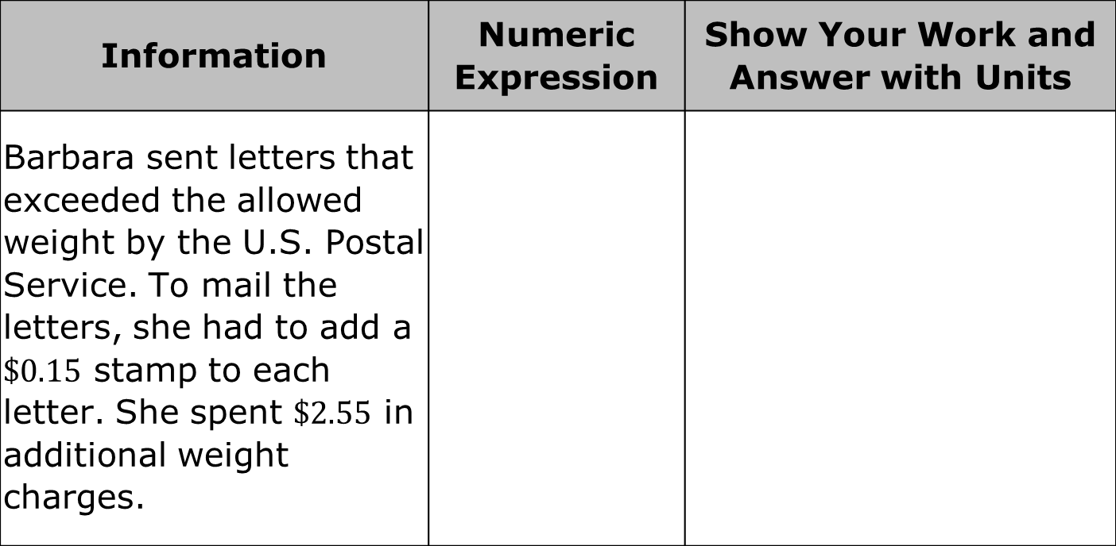
Information | Numeric Expression | Show Your Work and Answer with Units
Barbara sent letters that exceeded the allowed weight by the U.S. Postal Service. To mail the letters, she had to add a $\$0.15$ stamp to each letter. She spent $\$2.55$ in additional weight charges.
volume 1, pg. 59

Slide 22

Wrap-Up
volume 1, pg. 60

Slide 23






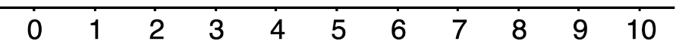
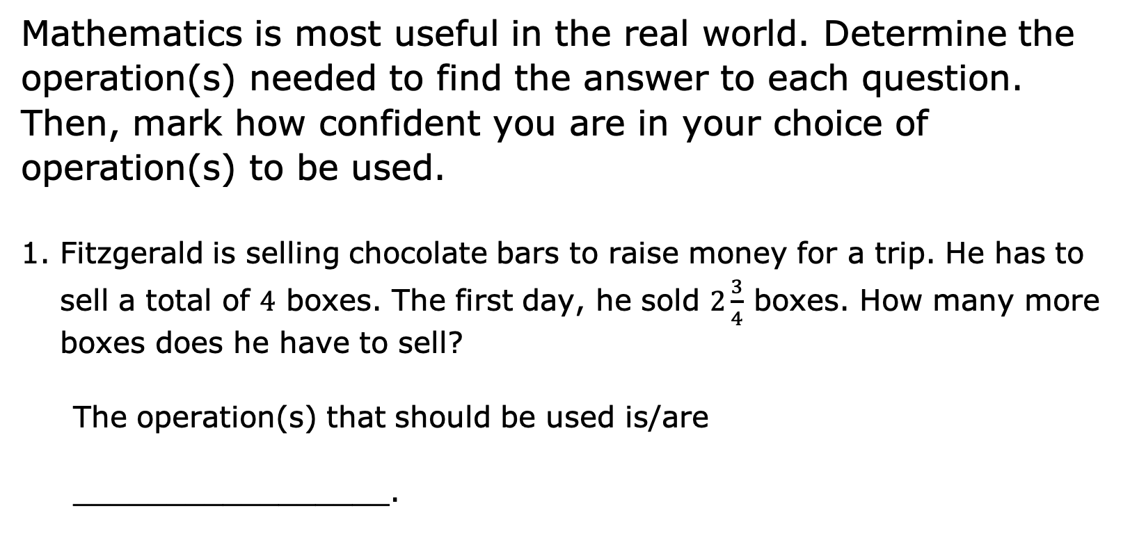
2.4.4 Wrap-Up: Reflection
Mathematics is most useful in the real world. Determine the operation(s) needed to find the answer to each question. Then, mark how confident you are in your choice of operation(s) to be used.
Fitzgerald is selling chocolate bars to raise money for a trip. He has to sell a total of $4$ boxes. The first day, he sold $2\frac{3}{4}$ boxes. How many more boxes does he have to sell?
The operation(s) that should be used is/are
_________________.
volume 1, pg. 60

Slide 24
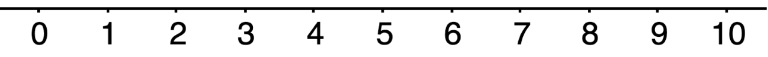
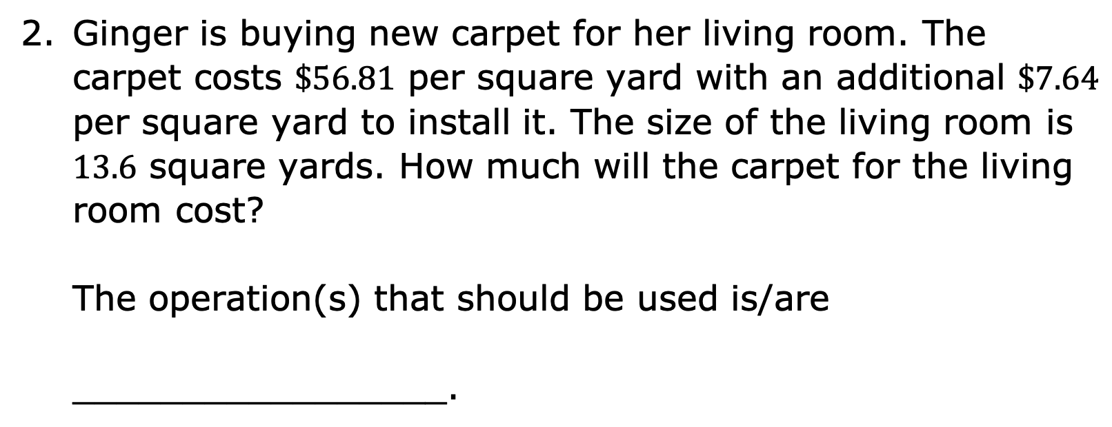
Ginger is buying new carpet for her living room. The carpet costs $\$56.81$ per square yard with an additional $\$7.64$ per square yard to install it. The size of the living room is $13.6$ square yards. How much will the carpet for the living room cost?
The operation(s) that should be used is/are
_________________.
volume 1, pg. 60

